Slide 1
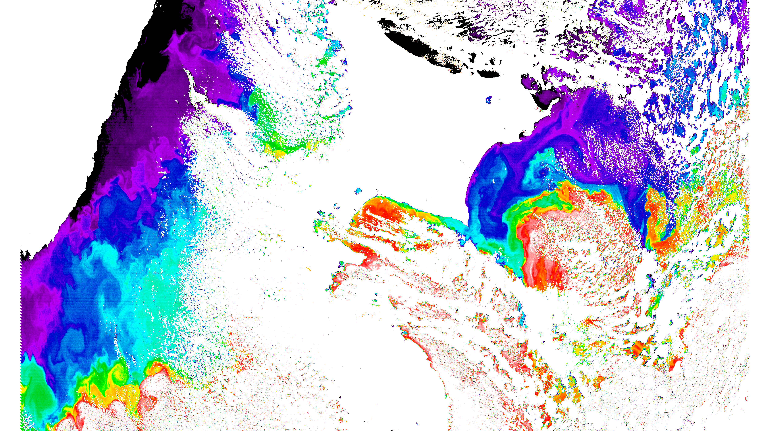
Working with satellite swath imagery
Brief overview of satellite data levels
Understanding quality-flag information
Validation of satellite data with ground truth data

Slide 2
Brief Overview of Satellite Data Levels
Level 0: Uncalibrated science data (engineering units) in a raw format.
Level-1A: Uncalibrated science data in an archive format (are Level 0 with ancillary information including radiometric and geometric calibration coefficients and georeferencing parameters appended)
Level-1B: Calibrated, geolocated science data (instrument/radiometric calibrations applied)
Level-2: Derived geophysical science products at the same resolution as the source Level-1 data. These variables can be ocean color, SST, etc., and are obtainable from JAXA, NASA, ESA, etc.
Level-3: Derived geophysical science products, temporally/spatially composited. Level-3 data are downloadable from Marine Environmental Watch of NOWPAP (regional), JAXA (global), NASA (global), etc.
Level-4: model output or results from analyses of lower-level data (e.g., Primary Productivity, CHL from YOC algorithm, etc.)

Slide 3
Brief Overview of Satellite Data Levels (L2: Level-2)
L2: Advantages
L2: Disadvantages
Unmapped data at native satellite swath coordinate system (spatial resolution and geometries)
Includes in a single file many geophysical parameters
Satellite-to-in situ­ validation exercises are performed with L2 data products
Unmapped images (geometrically distorted) and cannot be compared with other images
Data must be quality screened to remove low-quality data prior to use
Files with large data volume
Require more technical expertise to work with

Slide 4
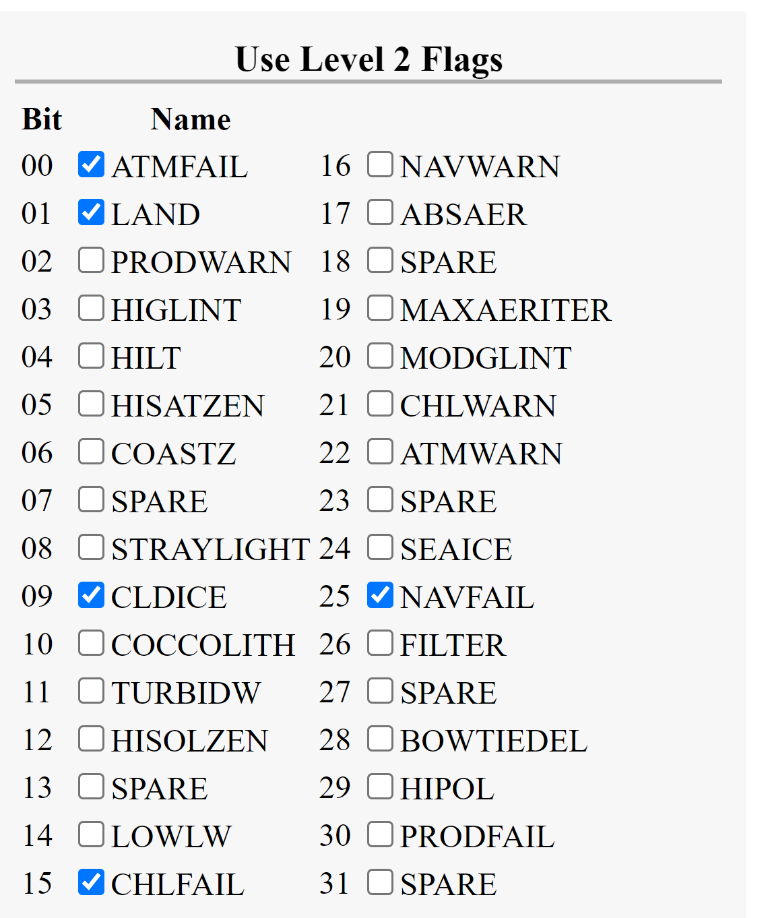
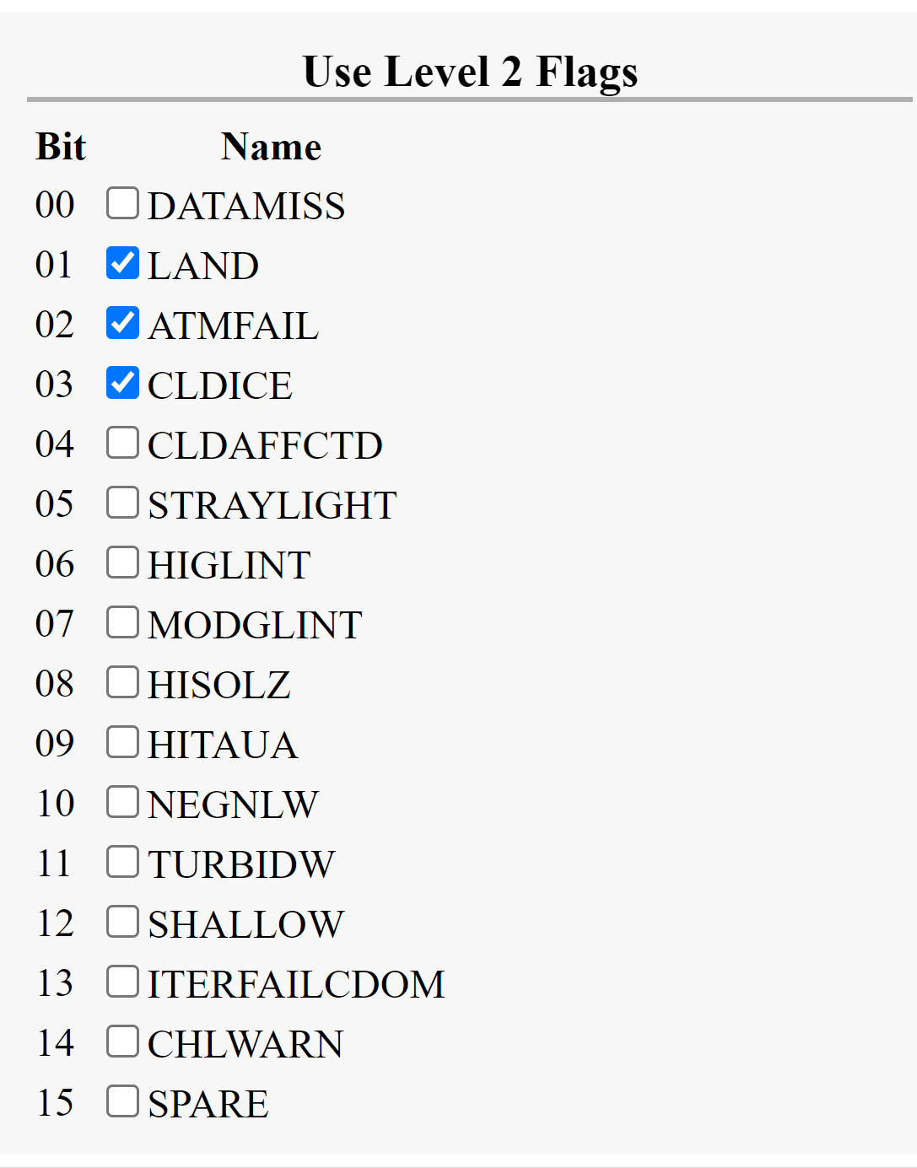
Understanding quality-flag information
NASA L2
JAXA L2 SGLI

Slide 5
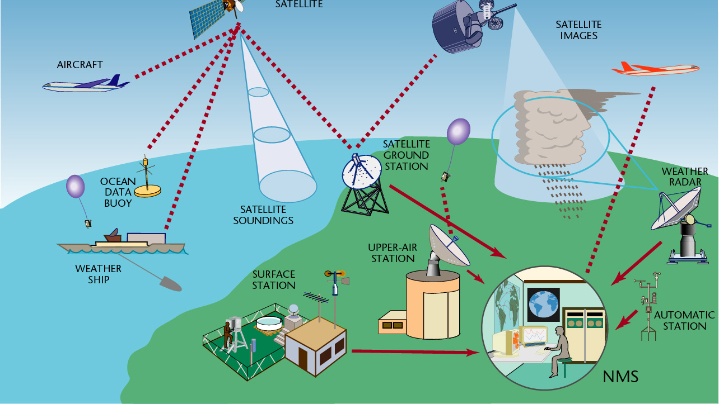
Satellite Data Matchup Tool (SMAT)

Slide 6
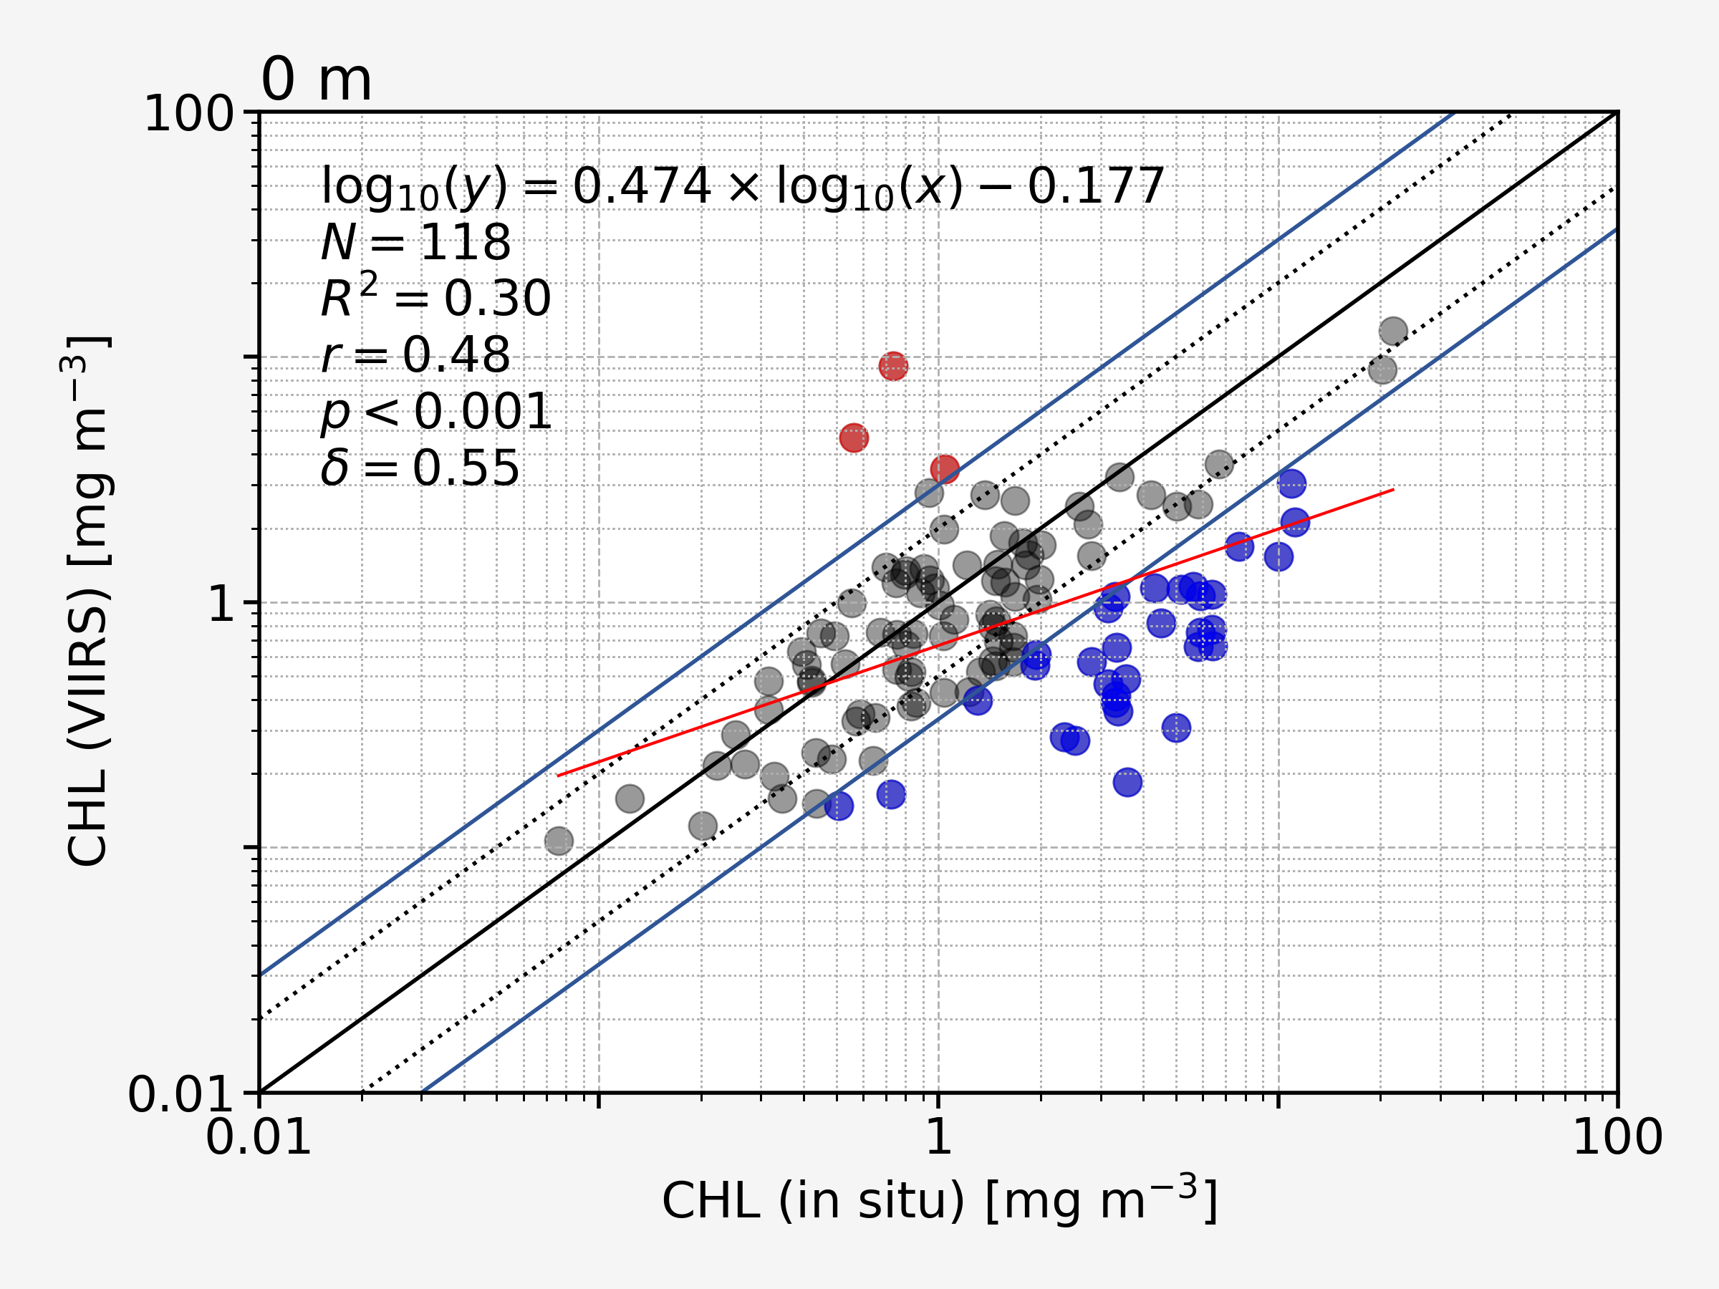
SMAT: Satellite Data Matchup Tool
Online Matchup Tool (https://ocean.nowpap3.go.jp/smat/)
Purpose
Matchup of satellite and in-situ observations
Composed of two parts
Selection Criteria
Validation Criteria

Slide 7
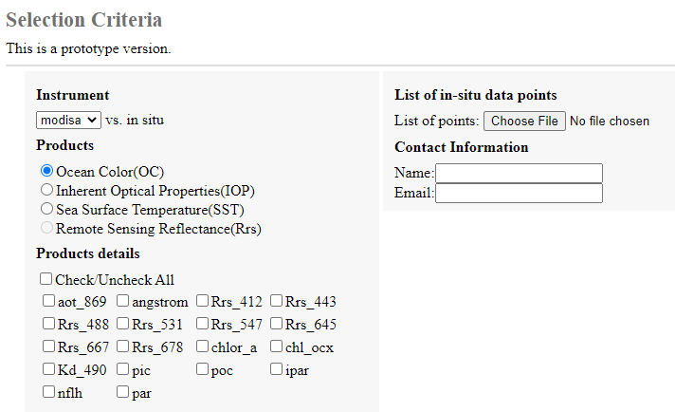
SMAT: (1) Selection Criteria
1. Instrument
(list of supported satellite)
2. Data Type
(OC, IOP, Rrs, SST)
2.1 Products
(list of products per data type)
Check all/Select a few

Slide 8
SMAT: (1) Selection Criteria
In-situ data
(upload a .csv file with a list of field observation points)
Contact
(notifications are sent to provided email with link of matchup data download)

Slide 9
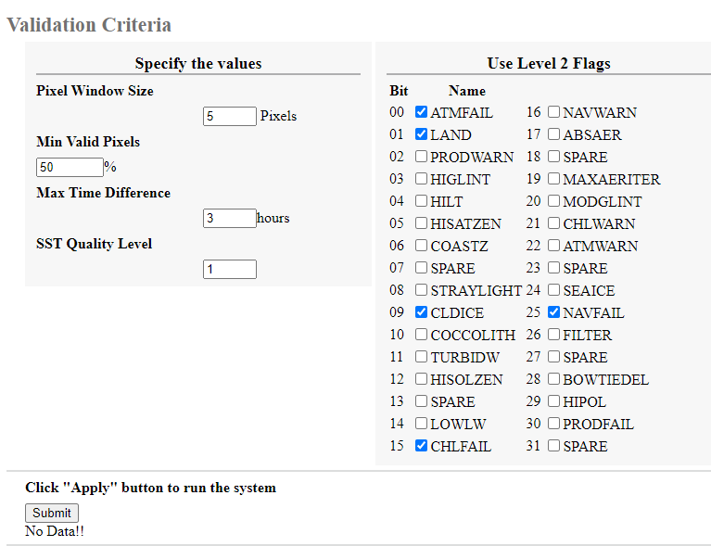
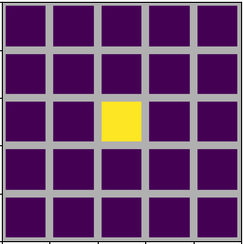
SMAT: (2) Validation Criteria
Pixel Window Size
data search window
yellow → in-situ point centre
Min Valid Pixels
(5x5=25, 50% = 13)
Max Time Difference
(in-situ—satellite time difference)
SST Quality Level
(quality number 0: best, 4: worst)

Slide 10
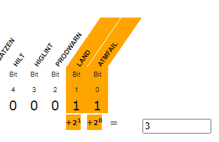
SMAT: (2) Validation Criteria
Level-2 Flags
16 or 32bits: Data Type dependent
https://code.earthengine.google.com/84446da594ddebc41fab3e50da212311

Slide 11
SMAT: (2) Validation Criteria
Submit
(Submit request for processing)

Slide 12
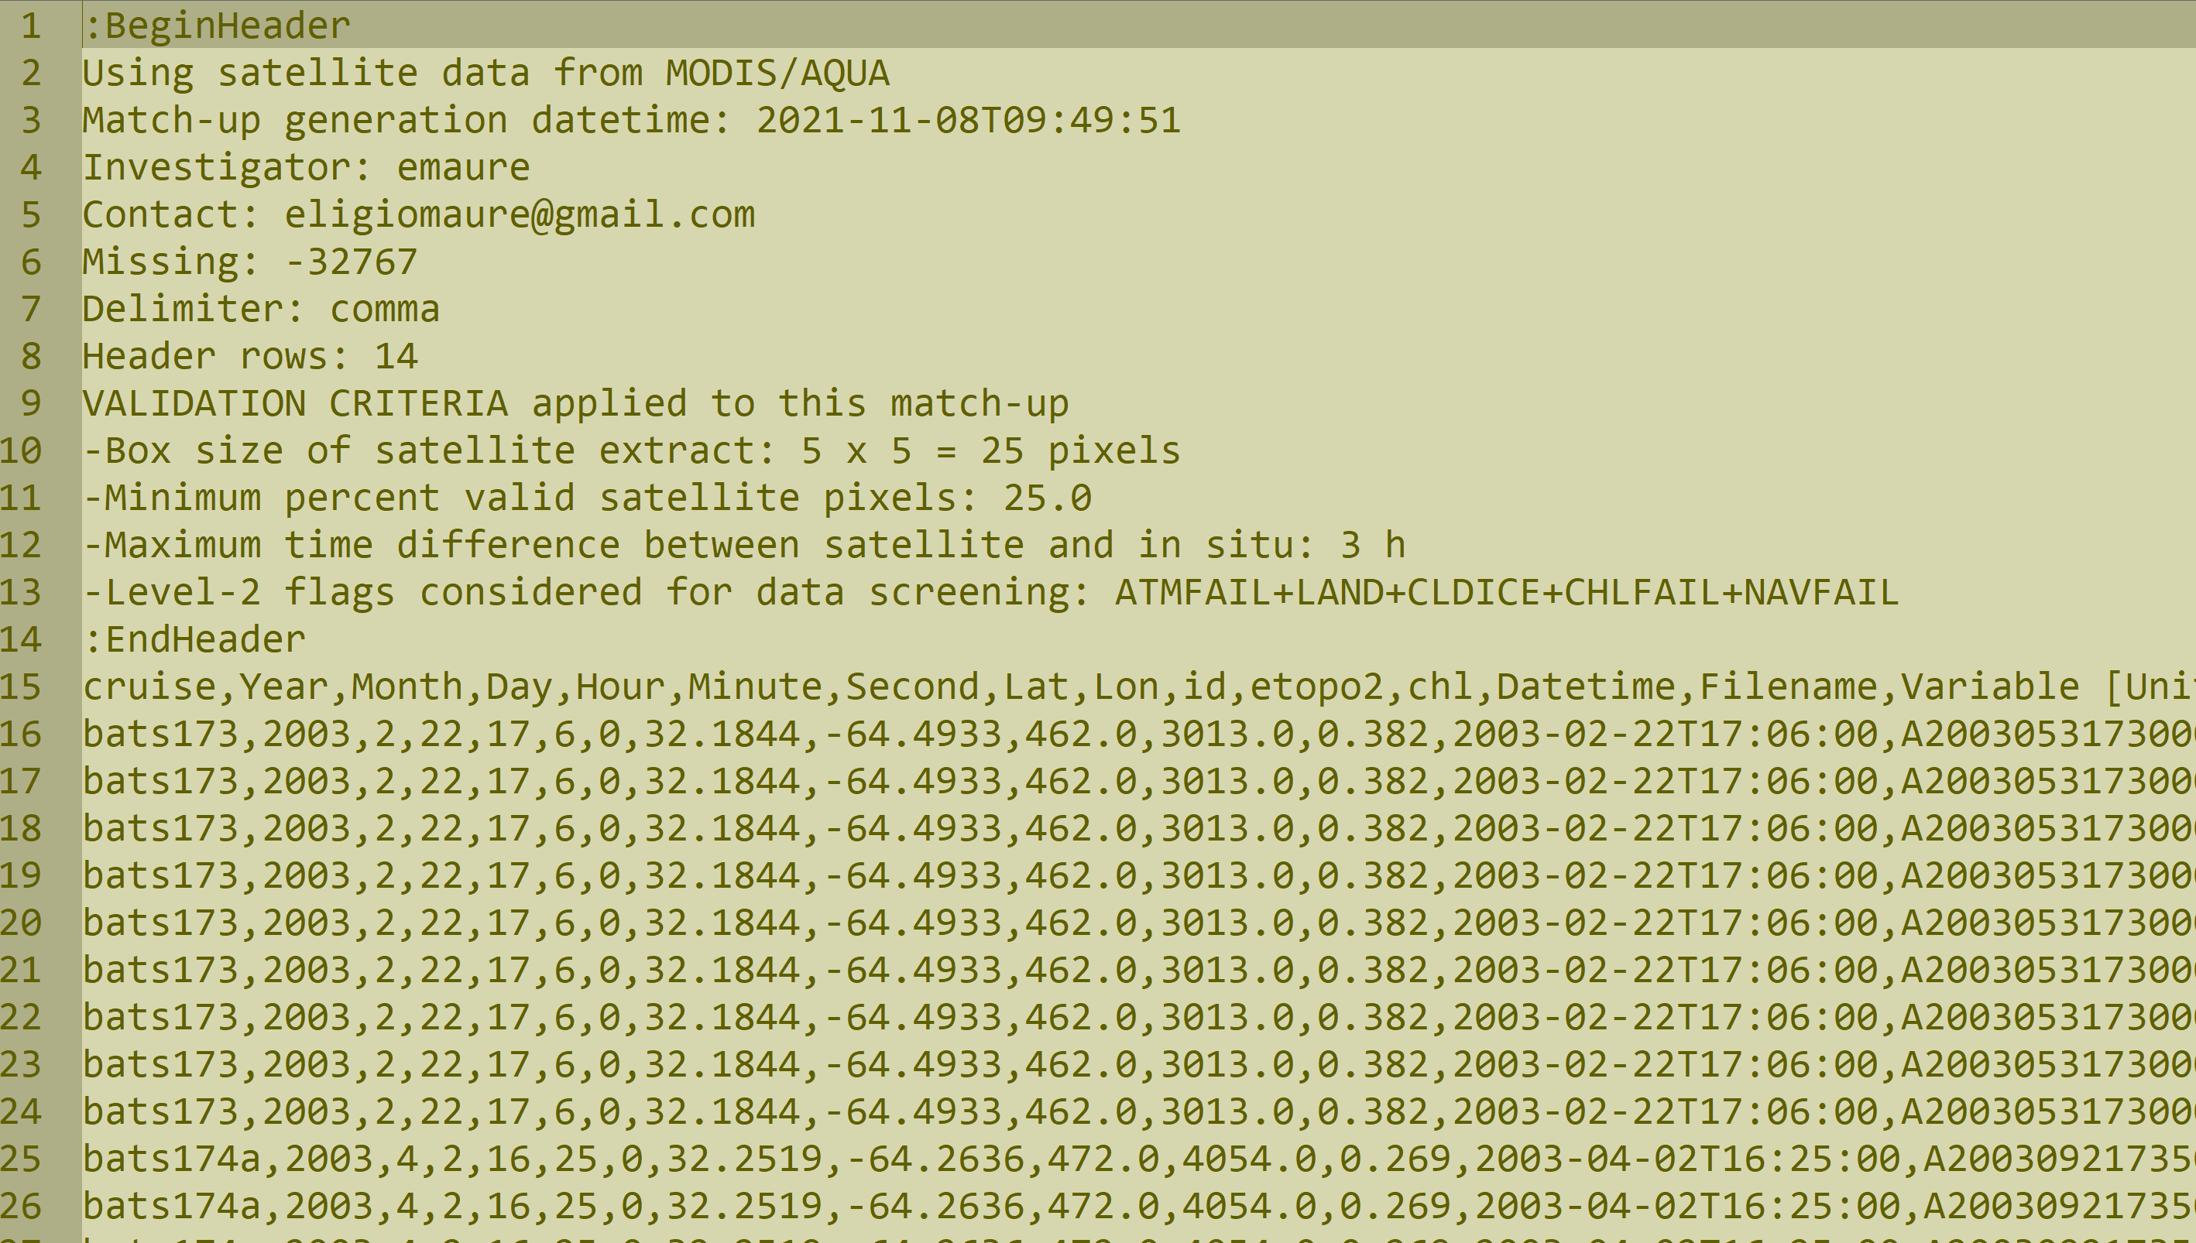
SMAT: Results

